Slide 1
What we believe and defend about the Bible
Inspiration, Infallibility & Inerrancy

Slide 2
How is the Bible coming under attack?

Slide 3
2 Timothy 3:16
All Scripture is God-breathed and is useful for correcting, teaching, rebuking and training in righteousness. (NIV)
“God-breathed” = inspired by God
Spirare = to breathe (Latin)
E.g. – respiratory system
Breath, wind, also “spirit”
Note Also 2 Peter 1:20-21

Slide 4
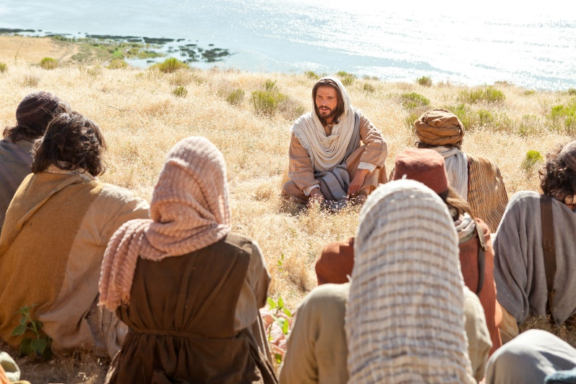
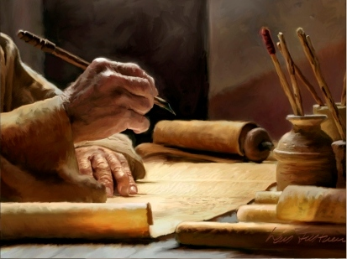
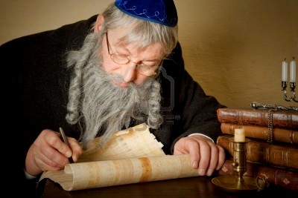
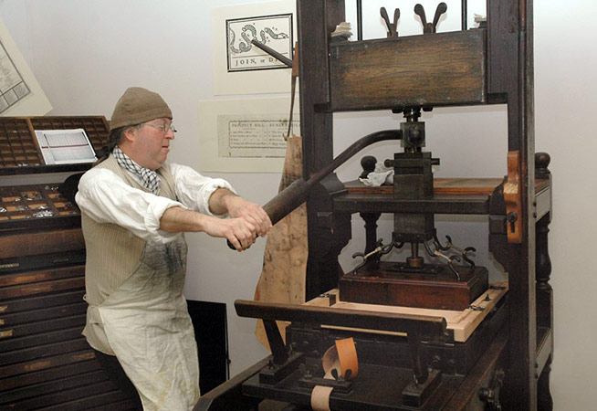
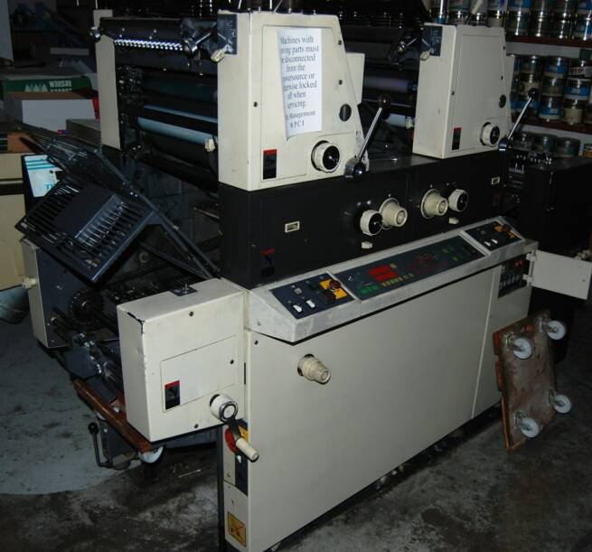
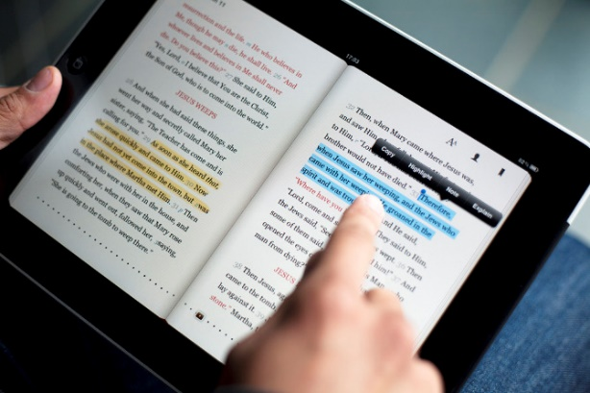
What is inspired?

Slide 5
What is inspired?
Messenger & “Message”
2 Timothy 3:16
2 Peter 1:20-21
Medium
Language?
Words and sentences?
Paper and ink?
Machines?
Electronic info?

Slide 6
What is inspired? (The message)
2 Timothy 1:13-2:1
What is a “pattern of sound teaching”?
I Timothy 1:16
“example” of Paul’s conversion
Pattern: summary outline, sketch

Slide 7
What is inspired? (The message)
Verbatim Dictation?
The NT itself indicates that it is not a word-for-word dictation of things that were said and done; but a reliable and trustworthy summary/outline.
This summary/outline is what was passed down as the standard for the “message” that was taught and preached.
“Summary Outline”
Matthew 5-7 & Luke 6
Acts 2:40
John 20:30-31, 21:24-25

Slide 8
Inspired
Inerrant
Mistake-free in what it addresses
Infallible
Reliable guide for truth

Slide 9
Infallibility & Inerrancy
The inspired message (not medium) is infallible and inerrant in…
its proper literary and socio-historical context
must properly identify the matters that the authors were intending to address/communicate;
inspiration/inerrancy/infallibility do not apply to matters that the authors did not intend to address
accordance with the perspective and conventions that best suited the authors at the time
different norms, conventions and expectations for precision in writing
Can you think of some Biblical controversies/debates that have been sparked by poor understanding of these concepts?

Slide 10
Concluding Thoughts
1) The message is inspired; the media through which the message comes (even the different words that can be used) vary and subject to limitations and imperfect conditions.
2) Attention and care needs to be taken to properly identify what a Biblical writer is intending to say or teach in a passage. (Exegesis!)
3) The message was not a verbatim recollection, but a summary outline to be used as a standard for teaching and preaching.
4) The inspired message is infallible and inerrant.

Slide 11
Examine Bart Ehrman’s criticism of the ideas of inspiration, infallibility and inerrancy.
How would you respond to these kinds of criticisms?

Slide 12
Responding to Ehrman’s Criticism
Do we need to recover the “exact words”?
Straw man argument
Verbatim dictation versus executive summary
We can absolutely have confidence in the message and its meaning while living with a certain level of inaccuracy and imprecision
Example: Compiling outlines in law school
Are there really as many mistakes creating as much confusion as Ehrman says?
Accounting error in mistakes. A mistake in a manuscript, which is then copied 50 times, is still just one mistake – not 50 mistakes.
The more diverse manuscript material scholars have, the better they are able to reconstruct with confidence the original text.
Do the exercise of copying.
This is why Bruce Metzger (Ehrman’s professor at PTS) has been famously quoted as putting the accuracy of modern NT versions at 99.5%
Ehrman himself knows this, which is why he is forced to mention that – “Most of these differences are completely immaterial and insignificant.”

Slide 13
Exercise – Make a Mistake!
Therefore, everyone who hears these words of mine and puts them into practice is like a wise man who built his house on the rock.

